Slide 1
Maps and Genealogy: ChicagoAncestors.org and The Atlas of Historical County Boundaries
Rebecca Lowery
Genealogy & Family History
Newberry Library
Chicago, IL

Slide 2
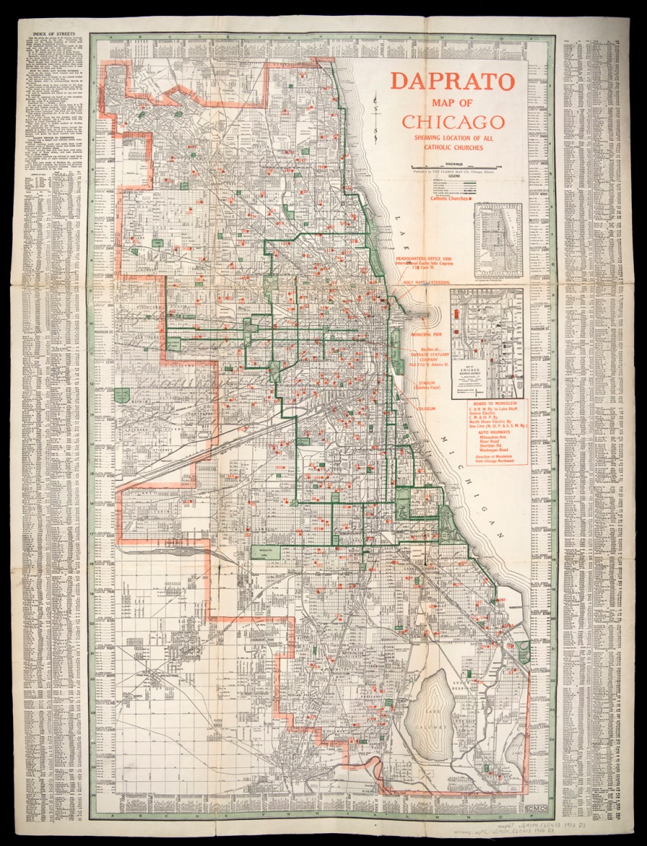
Background of ChicagoAncestors.org
We are presently in the second generation of the ChicagoAncestors.com program. It was first launched in 2007. The inspiration for it came from how often a particular map was used in the genealogical reference interviews.
This map was a 1926 map showing the Roman Catholic churches in Chicago and was produced as an advertisement for the Daprato Statuary. The map had all of the Chicago churches on it. As a result it was a great source for family historians trying to determine which Catholic church their ancestors might have attended.

Slide 3
ChicagoAncestors.org
This website is free, open to the public, and requires no ID or password. This new and enhanced version has a much larger map and is generally more accessible for the users.
We have brought over the previous information from the original version and have been adding more data as it becomes available.
The site has user comments sections as well as allowing the public to suggest additional data that might be useful on the sight. We have maintained the basic approach of searching by address but have expanded and enhanced those options to make searching smarter while not being burdensome.
So let’s take a look at the website.

Slide 4
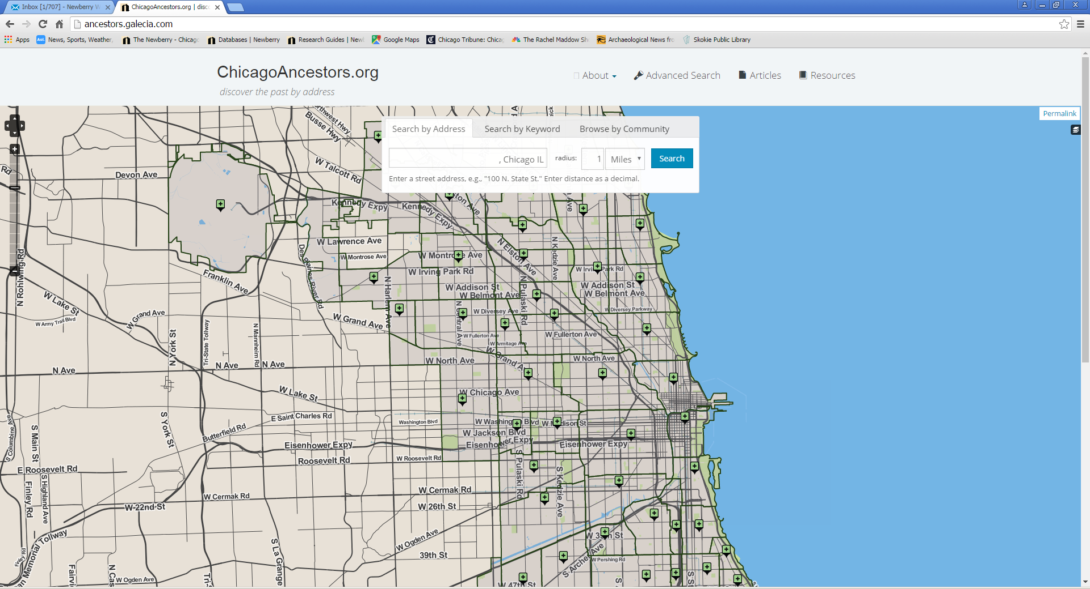
Home page

Slide 5
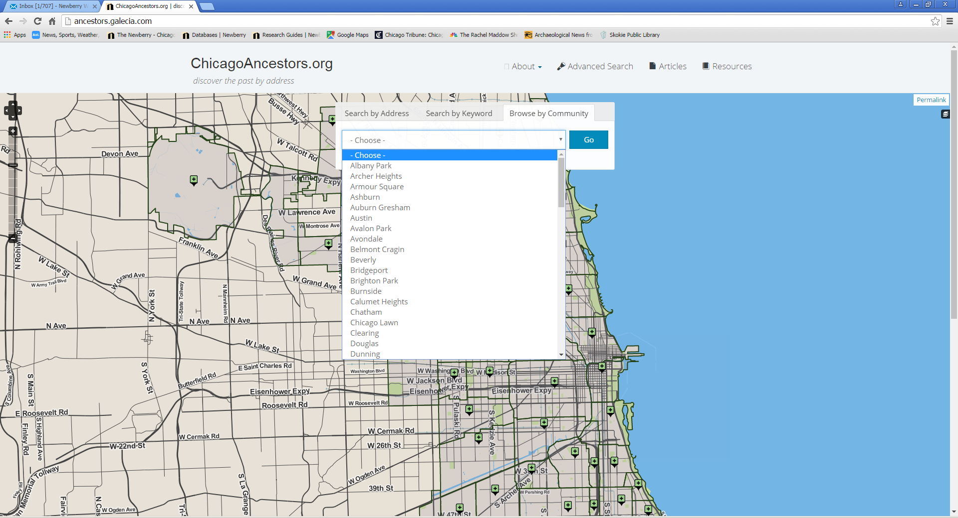
The old neighborhood: Or Community Areas as they are known locally

Slide 6
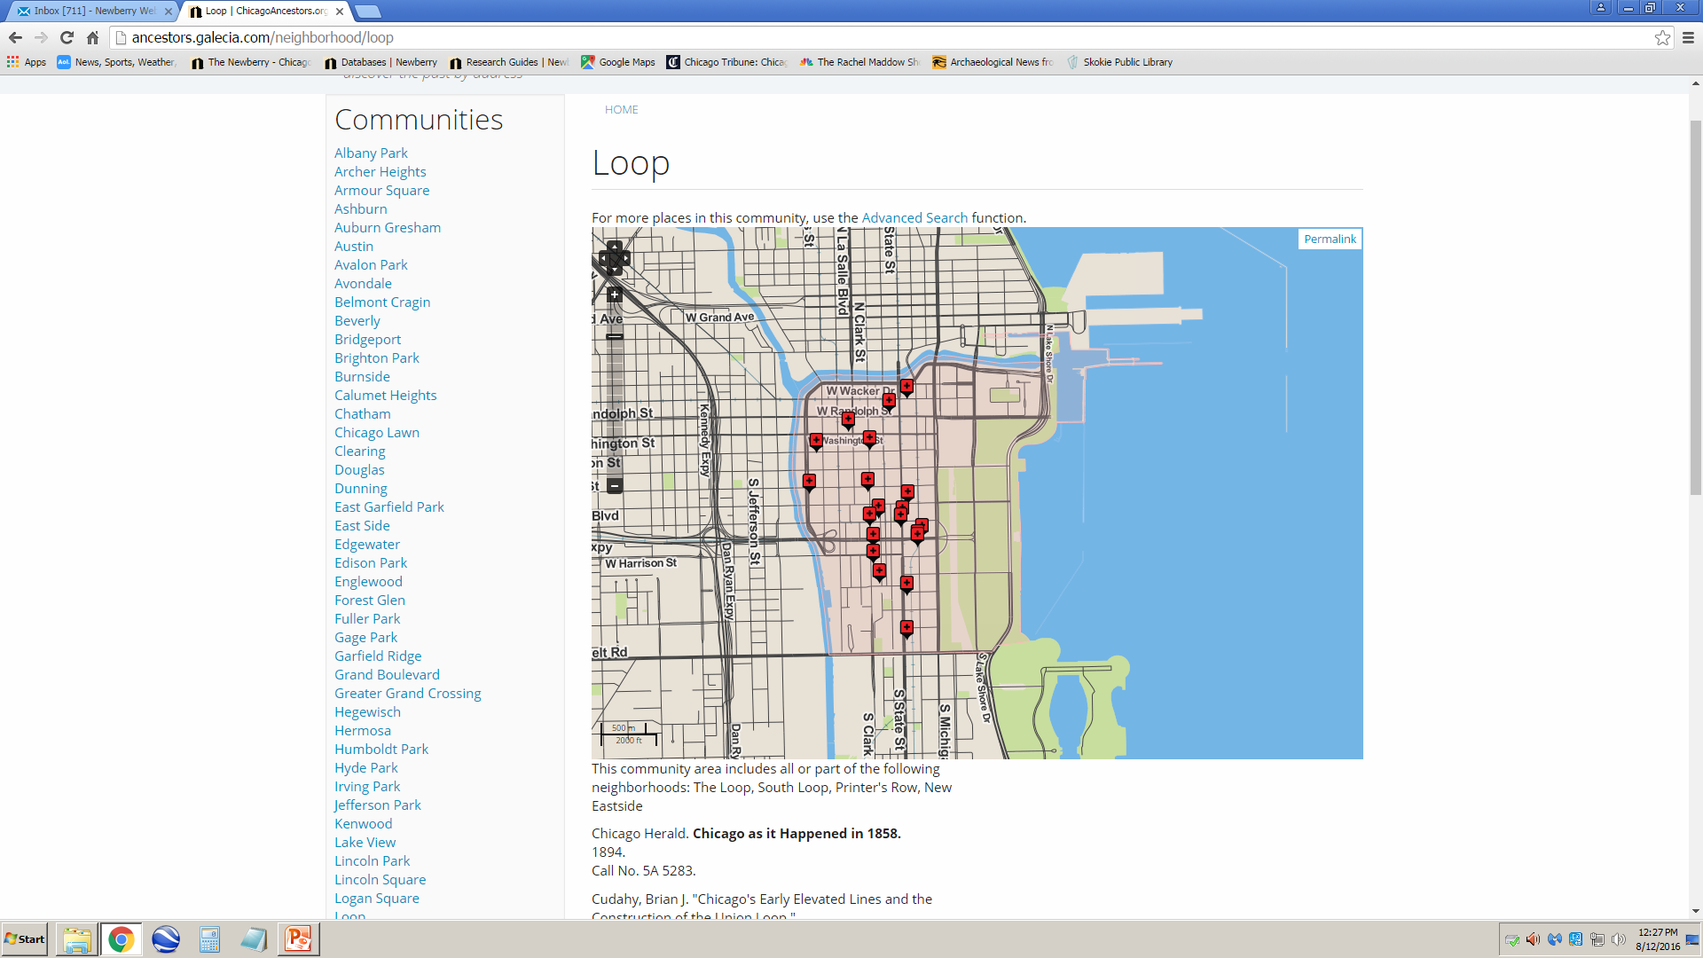
Learning about an area

Slide 7
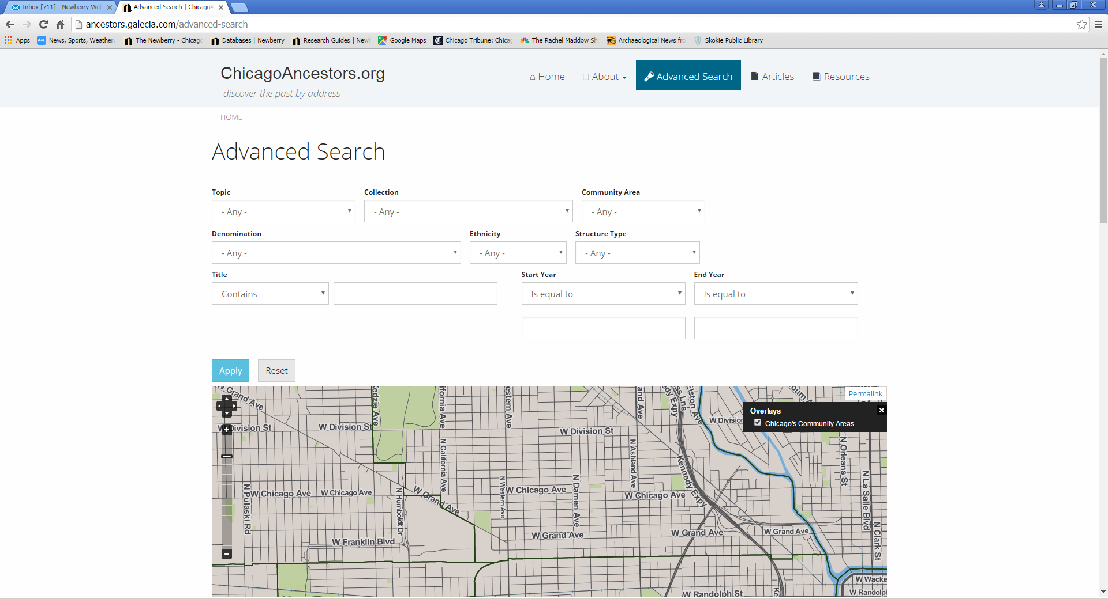
Advanced Searches

Slide 8
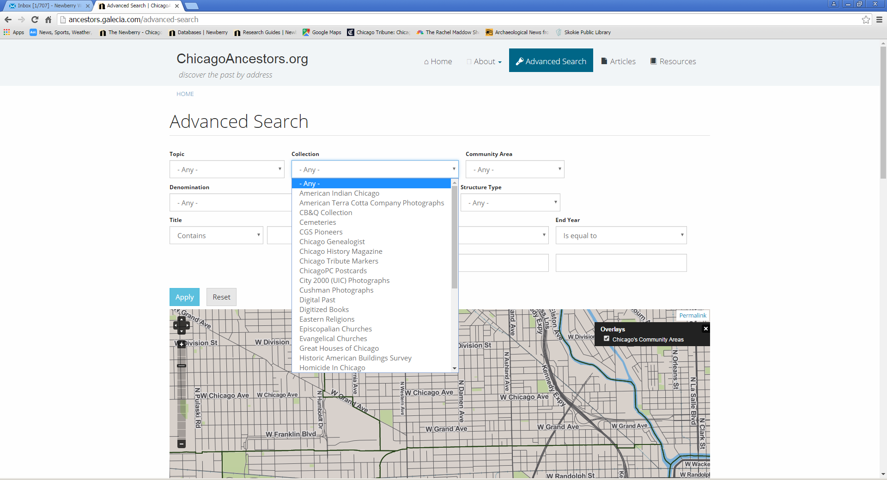
Sample of collections

Slide 9
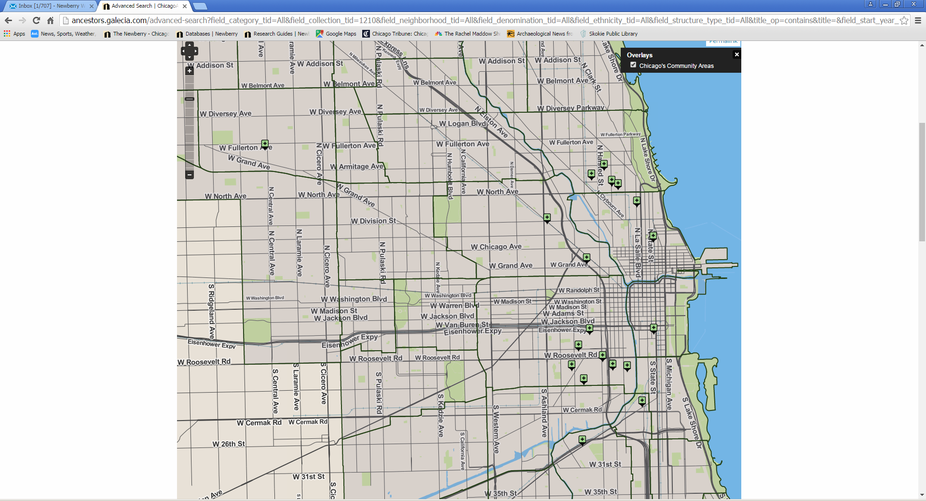
First a map is provided

Slide 10
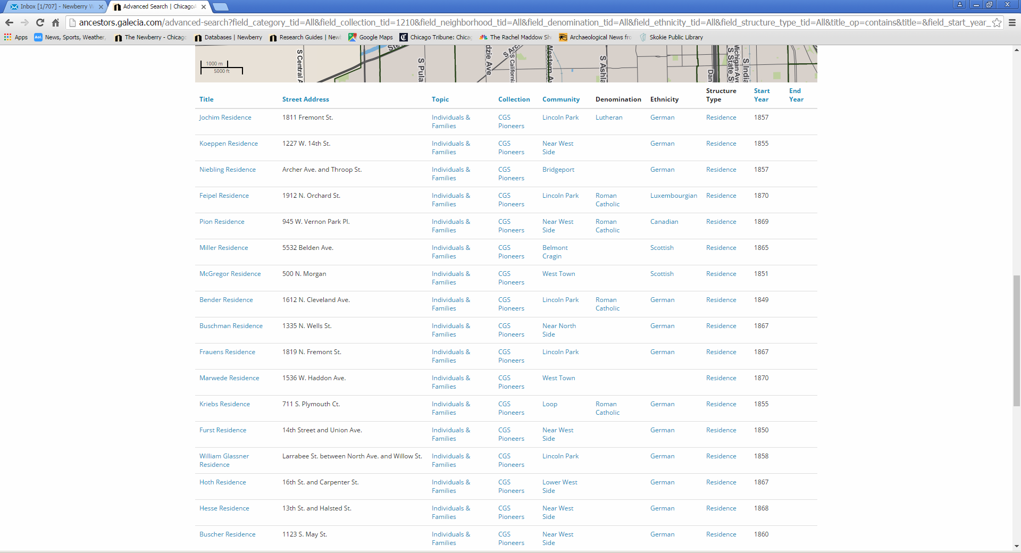
Then a listing of specific sites are given

Slide 11
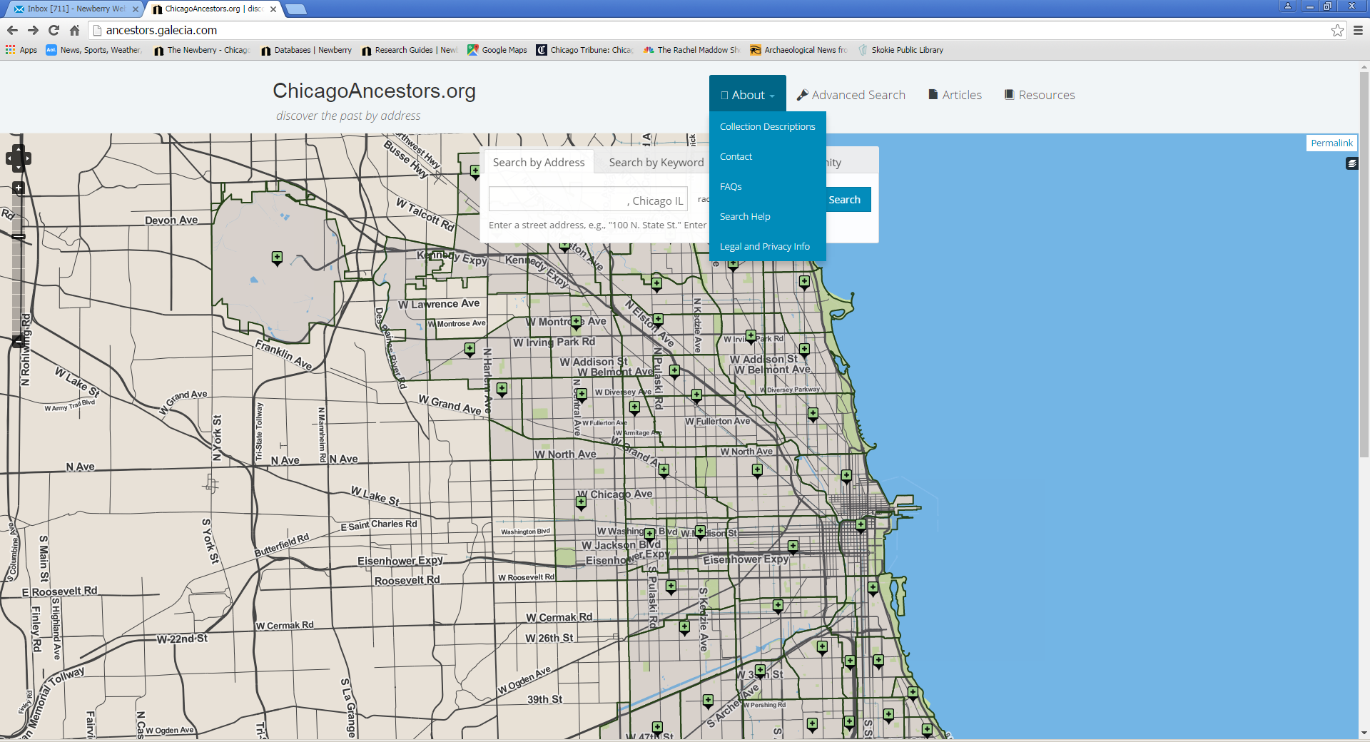
Beyond the map and list …

Slide 12
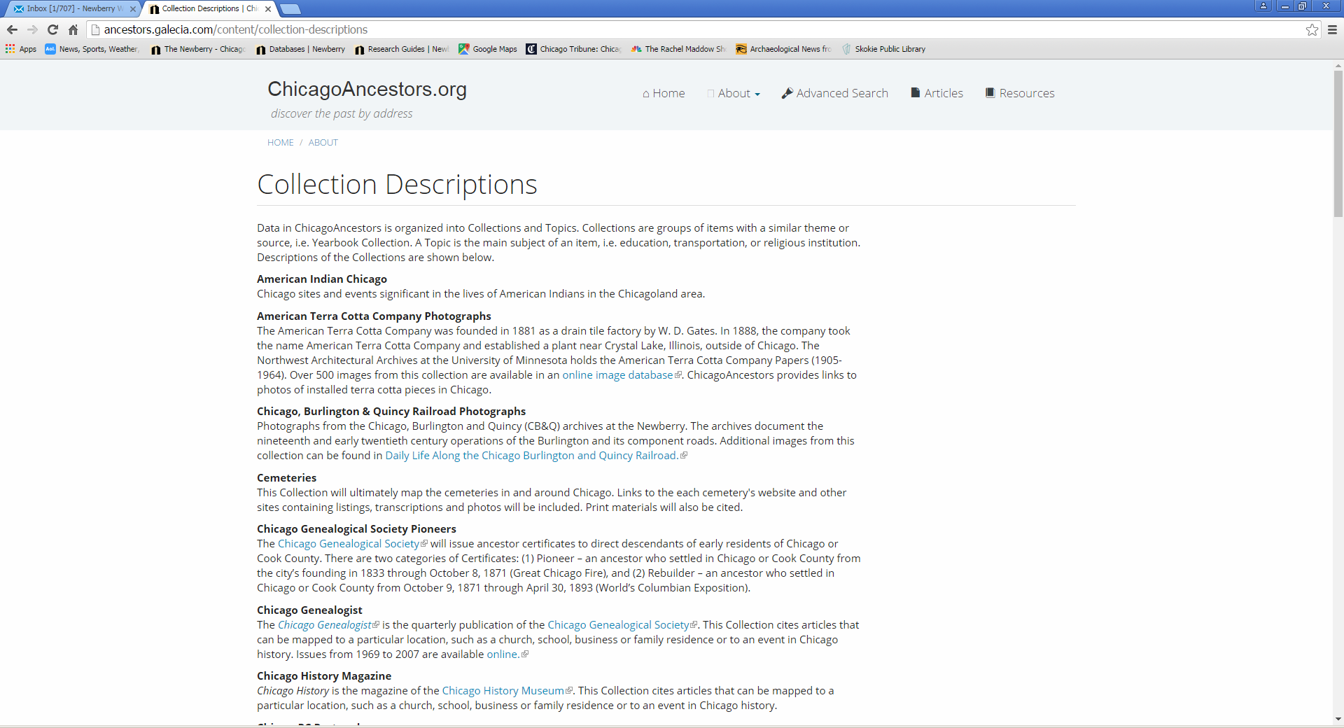
Collection descriptions

Slide 13
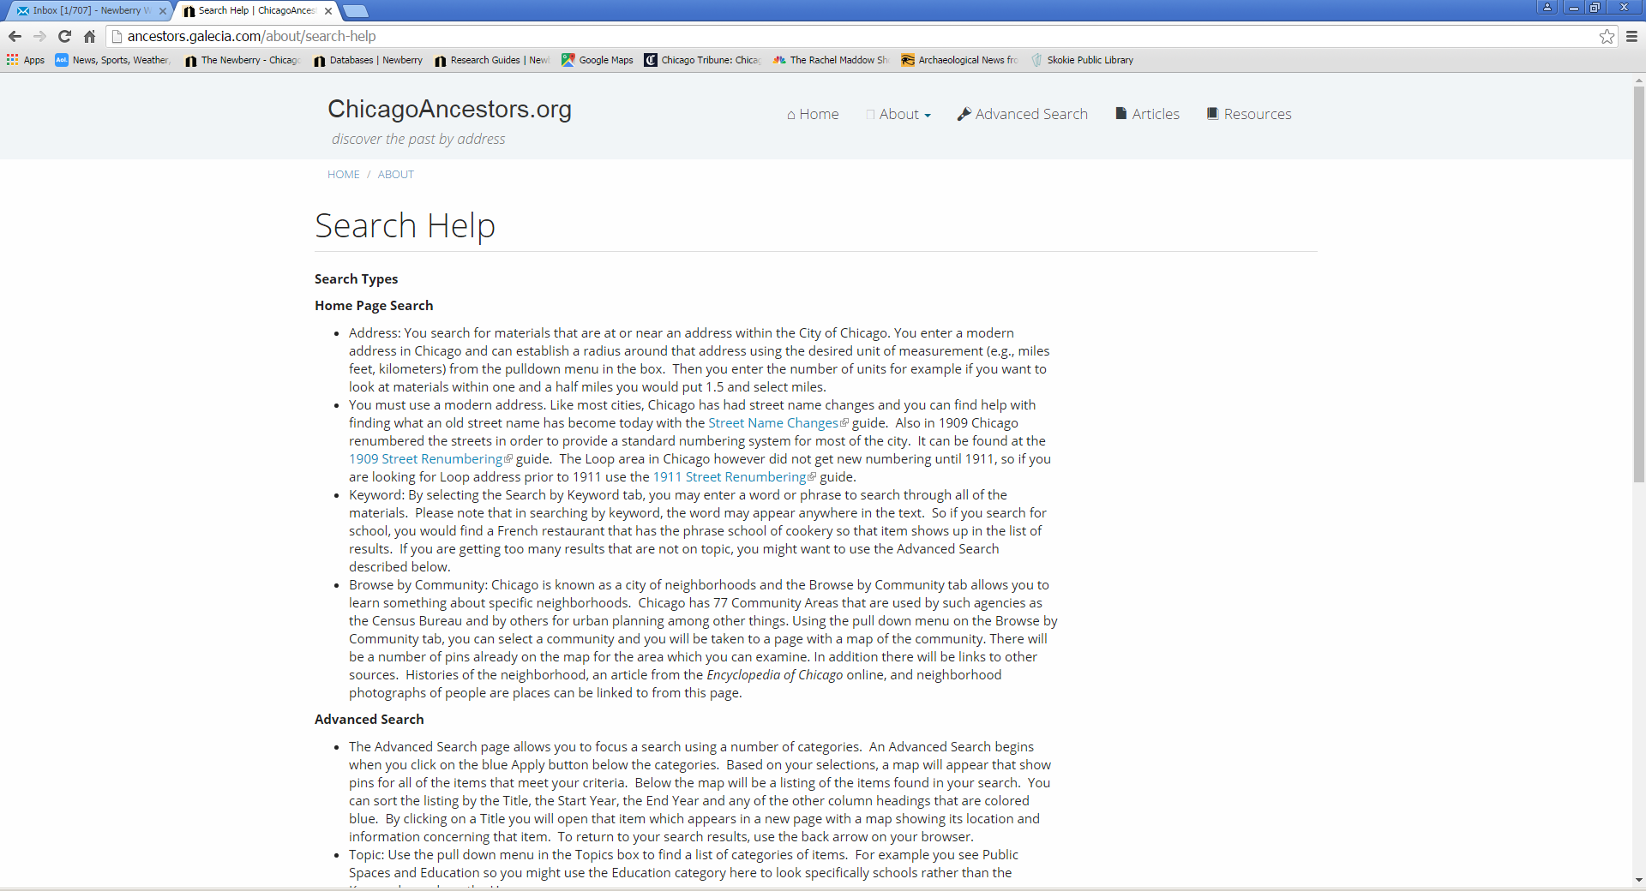
Help in searching: simple or advanced

Slide 14
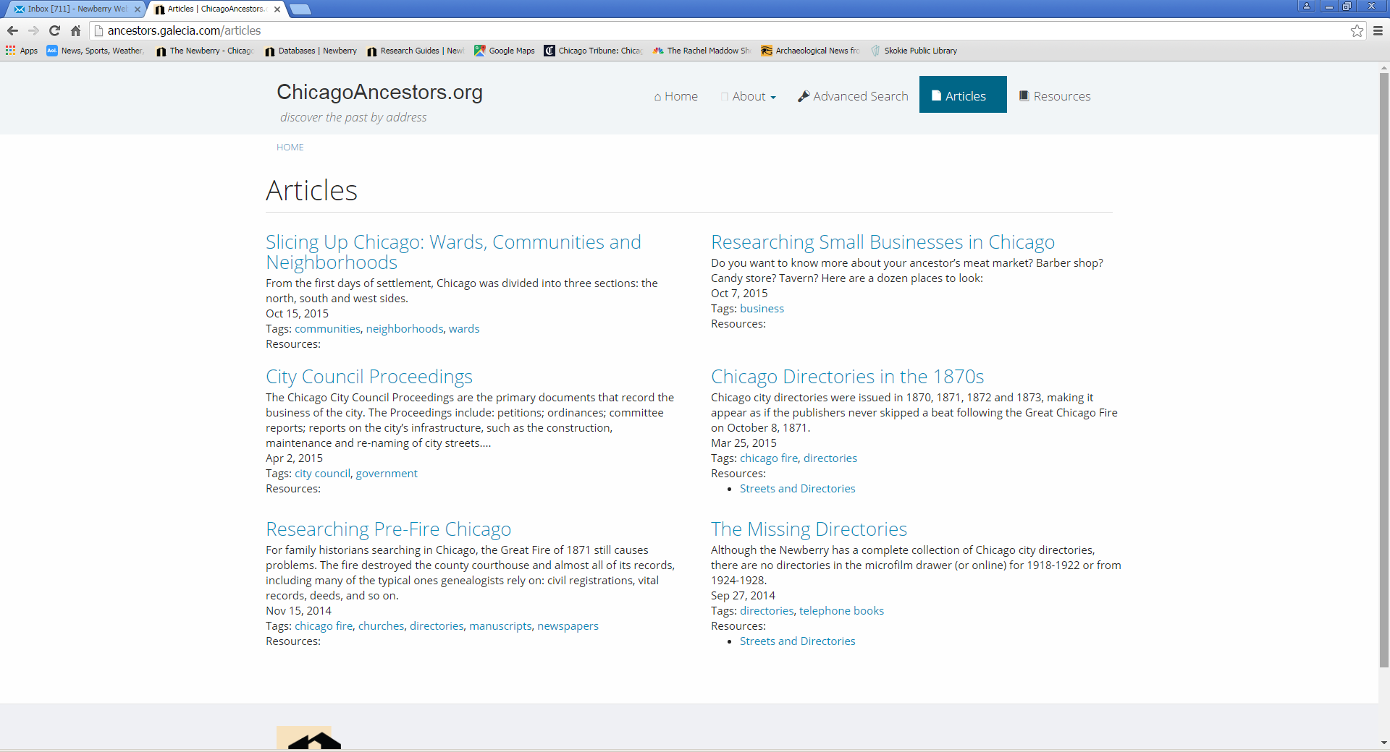
Articles to enhance understanding

Slide 15
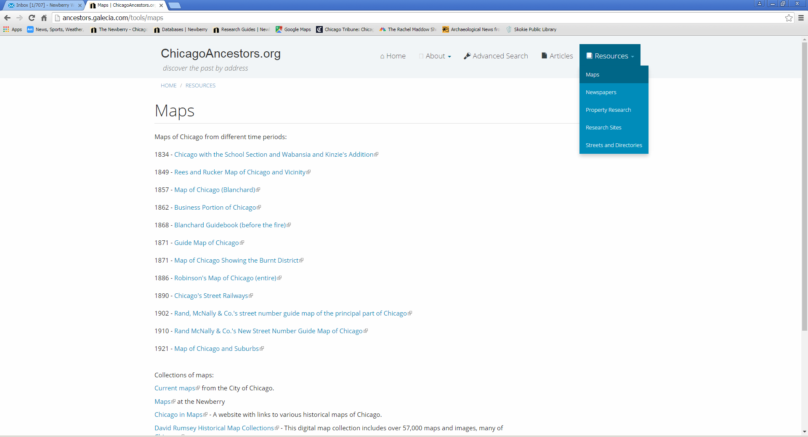
Additional resources including maps

Slide 16
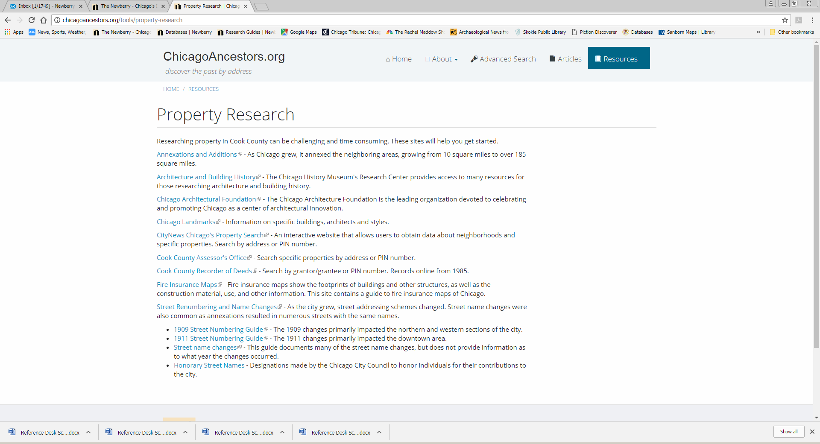
Property research

Slide 17
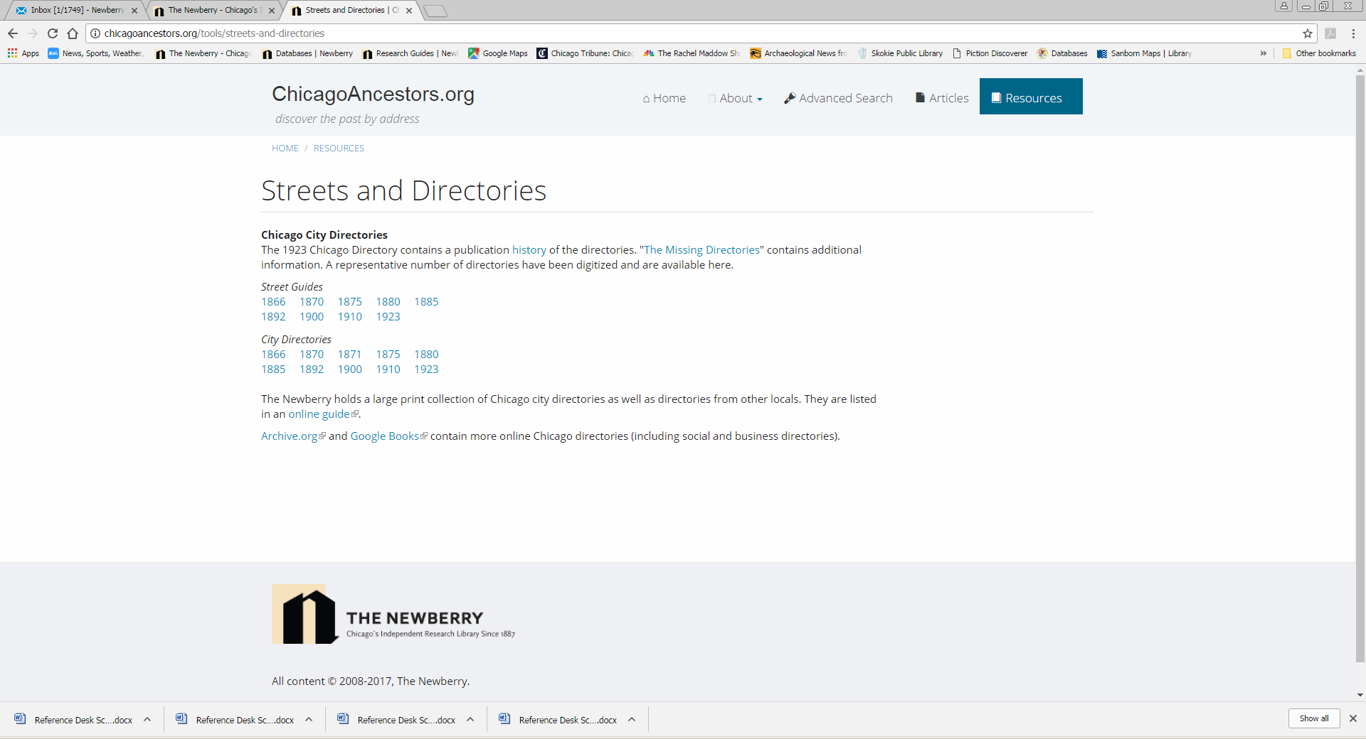
Street guides and city directories

Slide 18
Atlas of historical county boundaries
Newly (literally this month) revised, the Atlas is now available again in interactive form as well as the static maps.
http://publications.newberry.org/ahcbp/
Please feel free to contact us. We really do want you to give it a good test drive and let us know what shakes, breaks or doesn’t work.

Slide 19
Credit where credit is due
The ChicagoAncestors.org project was originally funded with a grant through LSTA and is maintained and enhanced by continued funding of the Newberry Library.
Original creators of the website were Jack Simpson, Ginger Frere, and Matt Rutherford. They were assisted by a number of interns and students who provided essential work to the project.
The Atlas of Historical County Boundaries was originally funded by an NEH grant and further funding has come from the Newberry Library. The Atlas staff is enumerated at http://publications.newberry.org/ahcbp/project.html .

